Slide 1
Conceptual Design
Brian Quinn, Mark Paluta, Eliseo Miranda, Pat Wall

Slide 2
Design Drivers
1.) Low Weight
2.) High Lift/Drag (L/D)
Justification: Low weight helps all aspects of the mission. High L/D will help with glide.

Slide 3
Figure of Merit (FOM) Analysis
 | Weight | High L/D | Size | Ease of Construction | Stability & Control | Payload | Bias
Weight | 0.00 | 4.00 | 4.00 | 4.00 | 4.00 | 5.00 | 23 %
High L/D | 2.00 | 0.00 | 4.00 | 4.00 | 3.00 | 5.00 | 20 %
Size | 2.00 | 2.00 | 0.00 | 2.00 | 2.00 | 2.00 | 11 %
Ease of Construction | 2.00 | 2.00 | 4.00 | 0.00 | 1.00 | 3.00 | 13 %
Stability & Control | 3.00 | 3.00 | 4.00 | 5.00 | 0.00 | 4.00 | 21 %
Payload | 1.00 | 1.00 | 4.00 | 3.00 | 2.00 | 0.00 | 12 %
Column Total |  |  |  |  |  |  | 100 %
Key Factors: Weight, High Lift/Drag, Stability and Control

Slide 4
FOM Analysis - Control Surface
 | 2x Ailerons, 2x Elevator, 2x Flaps | 2x Ailerons, 1x Elevators, 2x Flaps | 2x Ailerons, 2x Elevators | 2x Elevons | Row Totals | Bias
Weight | 1.00 | 2.00 | 3.00 | 5.00 | 11.00 | 23 %
High L/D | 5.00 | 4.00 | 3.00 | 1.00 | 13.00 | 20 %
Size | 1.00 | 2.00 | 3.00 | 5.00 | 11.00 | 11 %
Ease of Construction | 1.00 | 1.00 | 3.00 | 5.00 | 10.00 | 13 %
Stability & Control | 2.00 | 2.00 | 4.00 | 1.00 | 9.00 | 21 %
Payload | 0.00 | 0.00 | 0.00 | 0.00 | 0.00 | 12 %
Column Average | 1.88 | 2.02 | 2.85 | 2.77 | 54.00 | 100 %
Best Result: 2x Ailerons, 2x Elevators

Slide 5
FOM Analysis - Landing Gear
 | None | Trike | Skids | Retractable | Tail Dragger | Monowheel | Bias
Weight | 5.00 | 3.00 | 4.00 | 1.00 | 3.50 | 4.00 | 23 %
High L/D | 5.00 | 3.00 | 4.00 | 1.00 | 4.00 | 4.00 | 20 %
Size | 5.00 | 3.00 | 3.00 | 1.00 | 3.50 | 4.00 | 11 %
Ease of Construction | 3.00 | 5.00 | 3.00 | 1.00 | 4.00 | 2.00 | 13 %
Stability & Control | 0.00 | 5.00 | 1.00 | 3.00 | 2.00 | 1.00 | 21 %
Payload | 0.00 | 0.00 | 0.00 | 0.00 | 0.00 | 0.00 | 12 %
Column Average | 3.09 | 3.32 | 2.65 | 1.30 | 2.93 | 2.63 | 100 %
Best Result: Trike Landing Gear

Slide 6
FOM Analysis - Wing Configuration
 | Monoplane | Biplane | Tandem Wing/Canard | Flying Wing/Blended Body | Winglets | Bias
Weight | 4.00 | 3.00 | 3.00 | 5.00 | 5.00 | 23 %
High L/D | 3.00 | 4.00 | 3.00 | 3.50 | 2.00 | 20 %
Size | 3.00 | 1.00 | 3.00 | 4.00 | 5.00 | 11 %
Ease of Construction | 5.00 | 2.00 | 2.00 | 1.00 | 5.00 | 13 %
Stability & Control | 4.50 | 3.00 | 2.00 | 1.00 | 1.00 | 21 %
Payload | 3.00 | 3.00 | 3.00 | 1.50 | 3.00 | 12 %
Column Average | 3.81 | 2.85 | 2.66 | 2.81 | 3.33 | 100 %
Best Result: Monoplane (Single Wing)

Slide 7
FOM Analysis – Tail Configuration
 | Conventional | V-Tail | H-Tail | Importance
Weight | 4.00 | 4.00 | 2.00 | 23 %
High L/D | 5.00 | 5.00 | 2.00 | 20 %
Size | 3.00 | 3.00 | 2.00 | 11 %
Ease of Construction | 5.00 | 2.00 | 5.00 | 13 %
Stability & Control | 4.00 | 2.00 | 5.00 | 21 %
Payload | 3.00 | 3.00 | 3.00 | 12 %
Column Average | 4.10 | 3.29 | 3.14 | 100 %
Best Result: Conventional Tail

Slide 8
FOM Analysis - Engine
 | Tractor | Pusher | Bias
Weight | 4.00 | 4.00 | 23 %
High L/D | 4.00 | 2.00 | 20 %
Size | 3.00 | 3.00 | 11 %
Ease of Construction | 5.00 | 3.00 | 13 %
Stability & Control | 4.00 | 2.00 | 21 %
Payload | 3.00 | 3.00 | 12 %
Column Average | 3.90 | 2.82 | 100 %
Best Result: Tractor Configuration

Slide 9
Important Quantities from Spreadsheets
Aspect ratio = 7
Span = 5’ 6”
Length = 3’
Takeoff Weight = 3.7 lbs

Slide 10
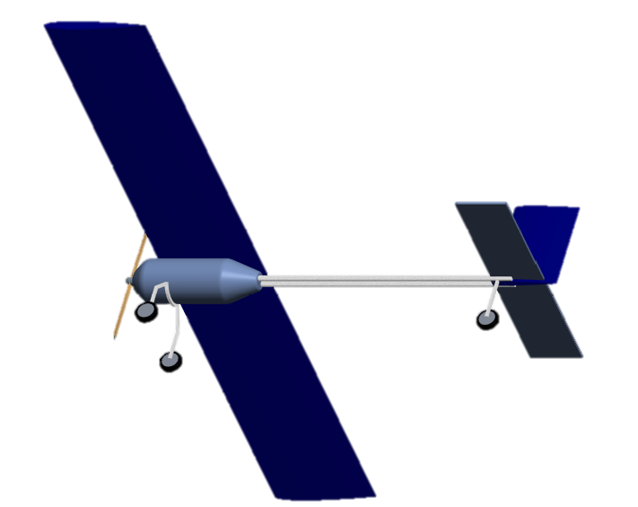
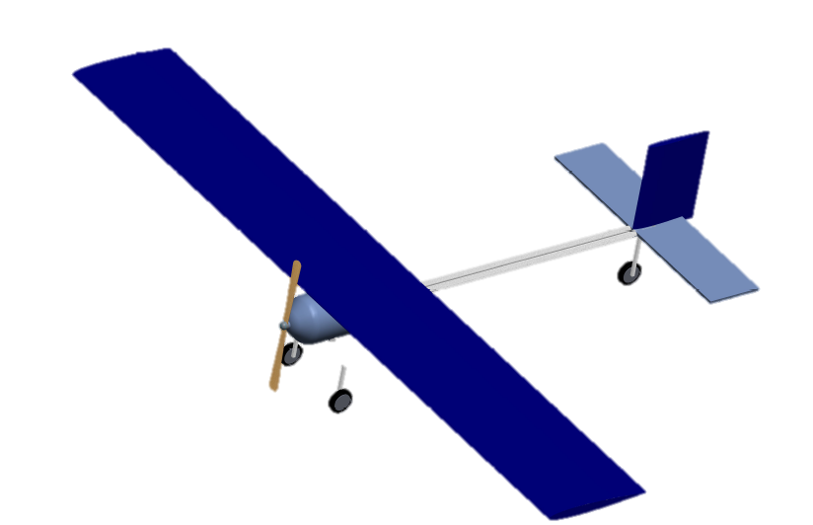
Conceptual CAD Model

Slide 11
Performance Predictions
Climb rate of 18.3 ft/s (for 10 s)
Descent rate of 2.5 ft/s
→ Glide time of 73 s

Slide 12
Summary
We seek to optimize primarily glide rate, and secondarily climb rate.
Primary design driver is weight
Secondary design driver is L/D

